Slide 1
Form Validation
Web Technology II

Slide 2
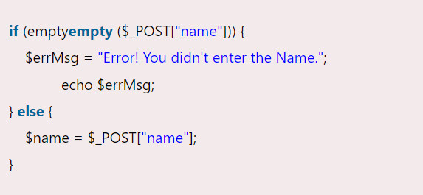
Empty String

Slide 3
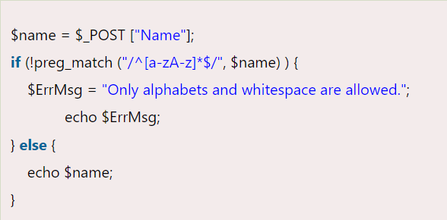
Validate String

Slide 4
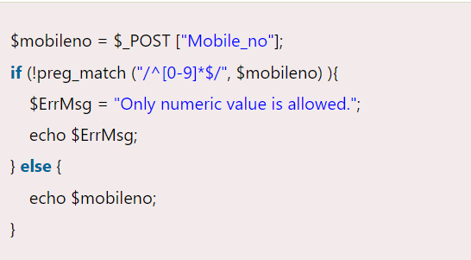
Validate Number

Slide 5
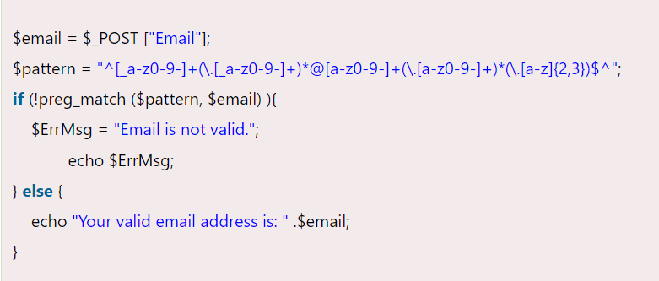
Validate Email

Slide 6
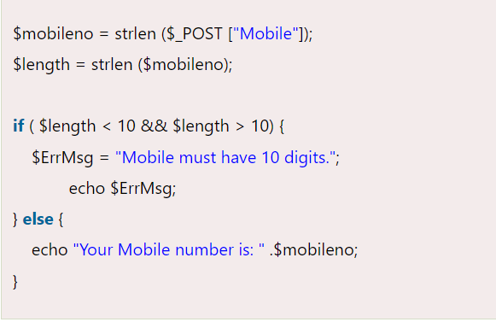
Input Length Validation

Slide 7
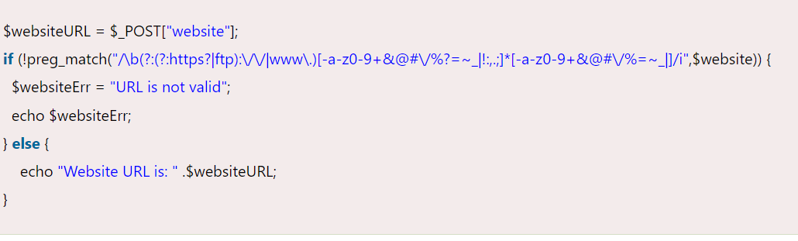
Validate URL

Slide 8
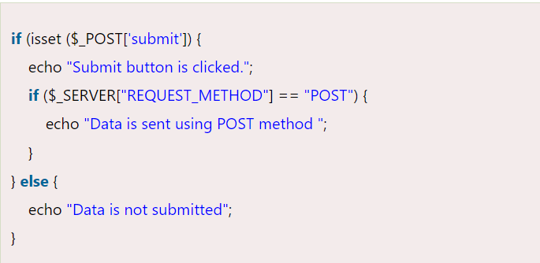
Button Click Validate

